Slide 1

Recent Vocations to Men’s Religious Communities
2024 CMSM PRE-Assembly
Atlanta, GA
Thomas Gaunt, SJ, Ph.D.
July 29, 2024

Slide 2
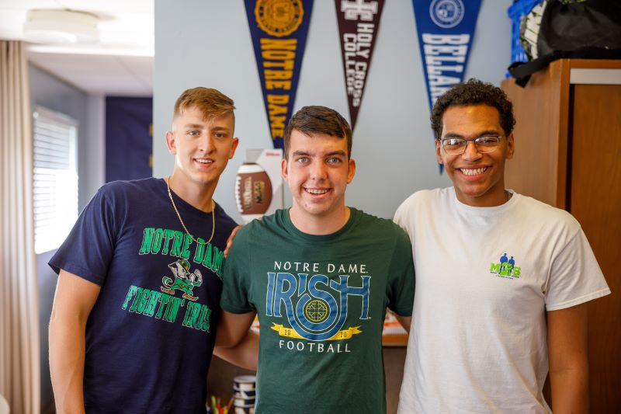

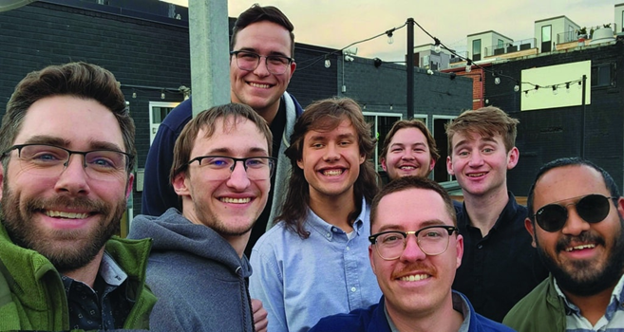
Who Might be Discerning Religious Life?

Slide 3
Vocational Considerations

Slide 4
The Seriousness of the Consideration

Slide 5
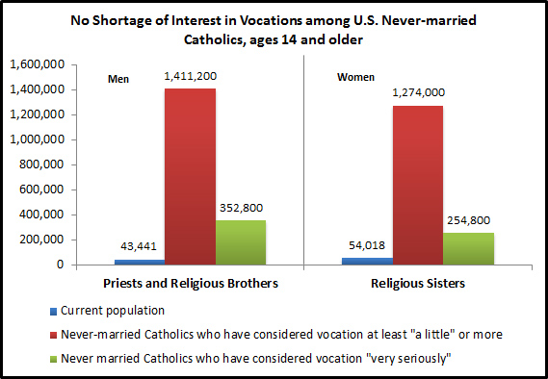
© 2013, CARA at Georgetown University
Source: Consideration of Priesthood and Religious Life Among Never-Married U.S. Catholics, 2012.
Notes:
Recent CARA research commissioned by the Secretariat for Clergy, Consecrated Life and Vocations on the vocational discernment of never married Catholics shows that a large number of Catholics have considered a vocation to priesthood and religious life.

Slide 6
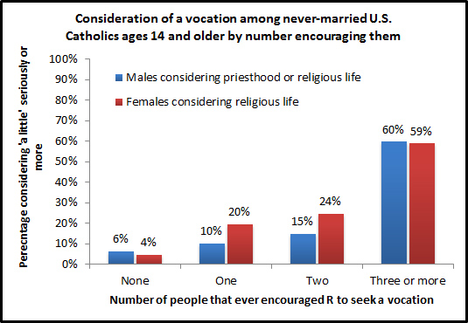
© 2013, CARA at Georgetown University
Source: Consideration of Priesthood and Religious Life Among Never-Married U.S. Catholics, 2012.
Notes:
And, the more encouragement they received the more who gave consideration to a vocation.

Slide 7
When in Your Life did You First Consider a Religious Vocation?

Slide 8
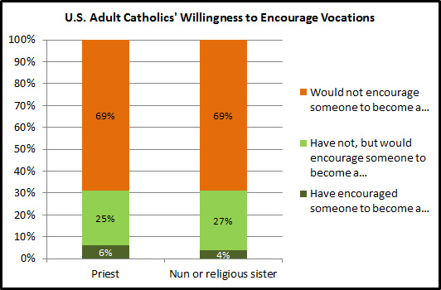
© 2013, CARA at Georgetown University
Source: Sacraments Today: Belief and Practice among U.S. Catholics, 2008.
Notes:
A particular challenge is the willingness of adult Catholics to encourage a vocation to priesthood or religious life. Nearly seven in ten Catholics say they “would not encourage” someone to consider priesthood or religious life. In more recent research, when asked why, four in ten said it was not there place to encourage a vocation. Another two in ten said they were not religious or didn’t have friends who would fit the mold or were unsure.
This raises important questions about the Church “calling forth” vocations.

Slide 9
Influence of College Personnel and Friends on Vocational Discernment
 |  | Type of College Attended the Longest:
 | All | Non-Catholic | Catholic
“Yes” a priest/sister/brother professor had a “significant positive influence” on vocational discernment | 64% | 46% | 72%
“Yes” a priest/sister/brother campus minister had a “significant positive influence” on vocational discernment | 56 | 55 | 57
“Yes” a campus minister encouraged vocational discernment | 51 | 46 | 59
Roommate at college had “very much” influence on discernment | 10 | 6 | 15
College friends were “very” supportive of vocational choice | 56 | 46 | 69
“Yes” friends encouraged vocational discernment during college | 72 | 63 | 84

Slide 10
“Frequently” Discussed Faith, Religion, and Prayer…
 |  |  | Type of College Attended the Longest:
 |  | All | Non-Catholic | Catholic
 | With Other Students Outside of Class | 49% | 40% | 62%
 | With Campus Ministry Staff | 37 | 35 | 41
 | In Class | 29 | 11 | 51
 | With Professors Outside of Class | 24 | 9 | 43

Slide 11
Former CVN Volunteers: Have You Considered a Vocation to Ordained Ministry or Religious Life?

Slide 12
Former CVN Volunteers: Have You Considered a Vocation to Ordained Ministry or Religious Life? If so, how Seriously?

Slide 13
Ecclesial Status of Catholic Volunteer Alumni
920 Catholic Men
 |  | Number of Respondents | Percent of Respondents
 | Priest | 36 | 3.9%
 | Deacon | 14 | 1.5%
 | Brother | 21 | 2.3%
 | Seminarian | 34 | 3.7%
 | Total | 105 | 11.4%

Slide 14
What are we learning?
A vocation to priesthood or religious life is seriously considered by hundreds of thousands of young adults. What is often missing is the “space for discernment” and an encouraging context.
1. There are a large number of men who seriously consider a vocation to priesthood & religious life.
2. Individual encouragement is important.
3. Catholic school experience creates the opportunities to consider a vocation and provides the space for a conversation to occur.
4. A year of volunteer service is often a key element of a person’s vocational decision.

Slide 15
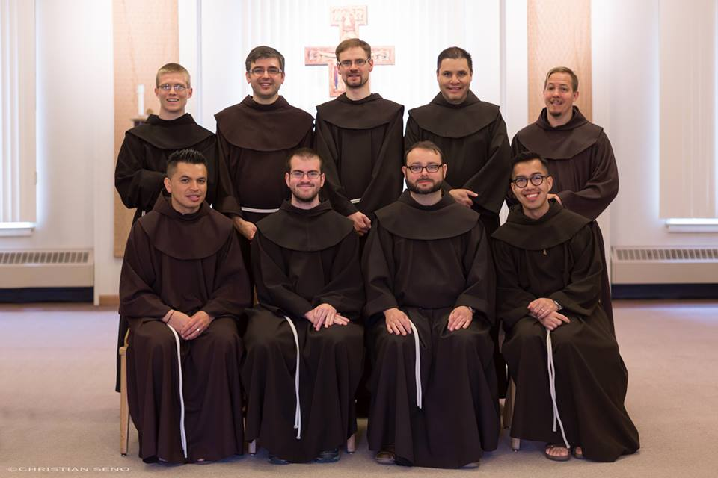
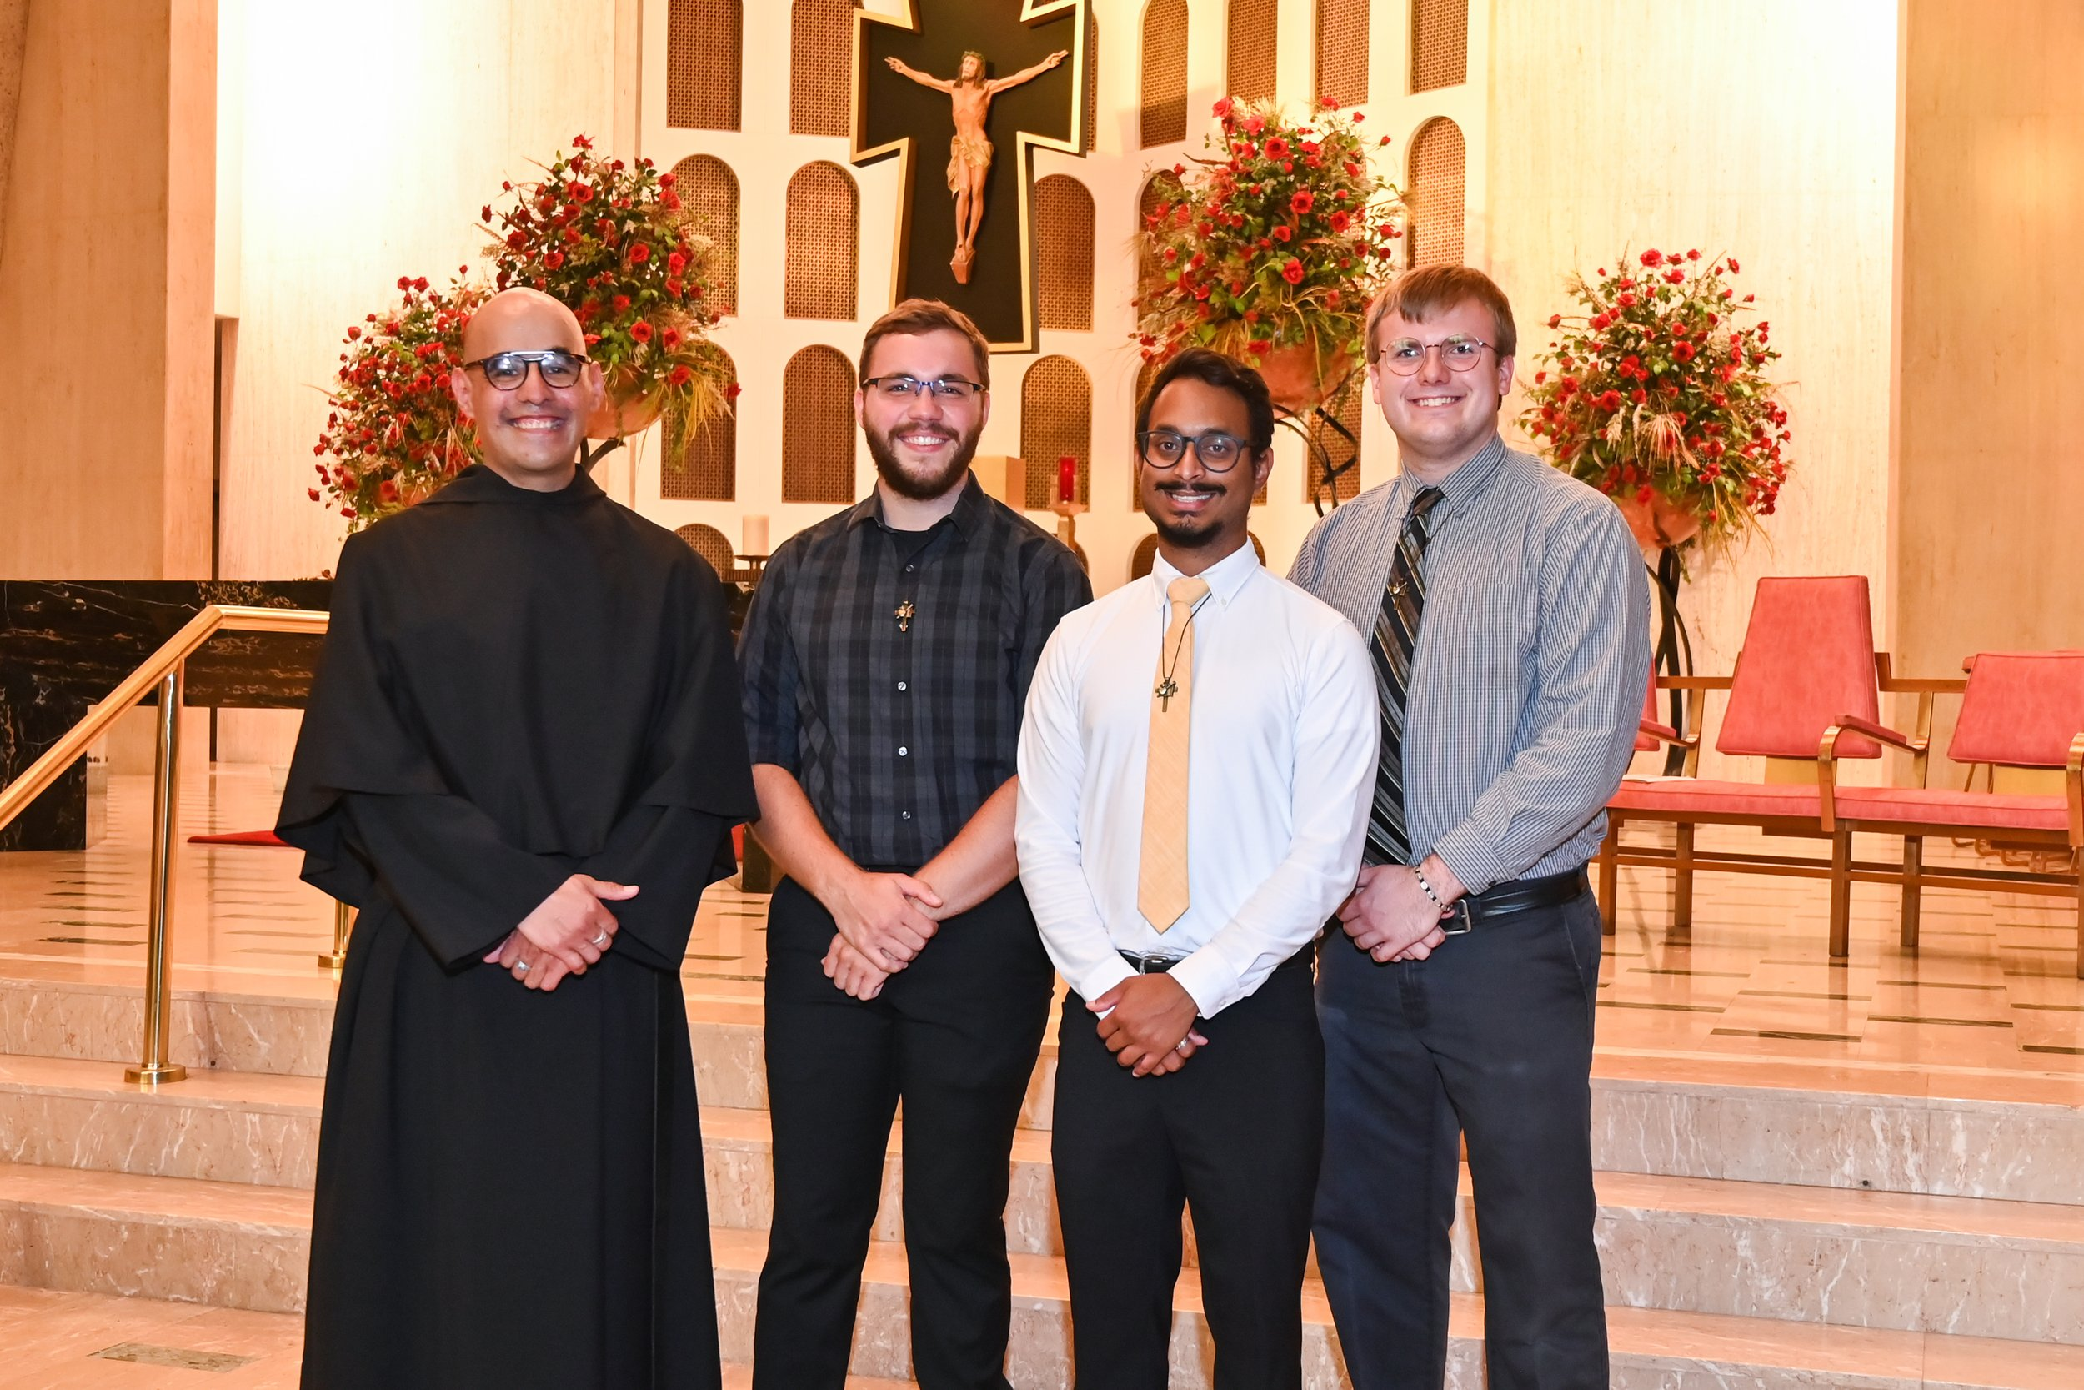
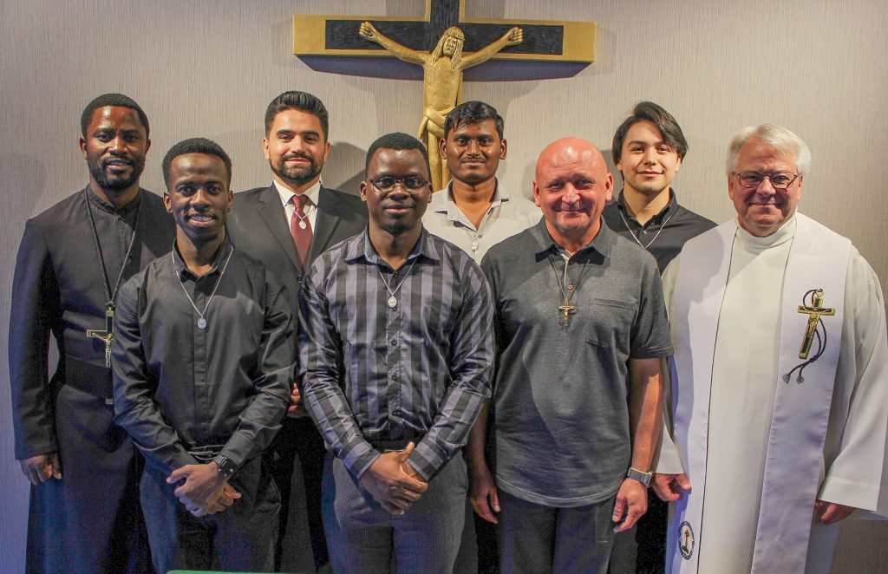
Who Are the New Members?

Slide 16
Age & Ethnicity
 | Age of Men Entering Religious Life in 2023
 | Percentage in each age category
 |  |  | % | %
 | 25 and younger |  | 41 | 41
 | Age 26-35 |  | 49 | 49
 | Age 36-45 |  | 6 | 6
 | Age 46-55 |  | 4 | 4
 | Age 56 and older |  | 0 | 0
 | Average age |  | 29 | 29
 | Median age |  | 26 | 26
 | Range in ages |  | 19-54 | 19-54
What best describes your racial or ethnic background?
Percentage in each category
 |  |  | %
 | Caucasian/European American/ White |  | 67
 | Hispanic/Latino |  | 12
 | Asian/Pacific Islander/Native Hawaiian |  | 5
 | African/African American/Black |  | 5
 | Mixed race or other |  | 11

Slide 17
Family Background
 | Catholic Background
 | Percentage responding
 |  | % | % | %
 | Catholic since birth | 86 | 86 | 86
 | Became Catholic later in life | 14 | 14 | 14
 | Religious Background of Respondents’ Parents
 | Percentage responding
 |  |  |  | %
 | Both parents Catholic |  |  | 74
 | Mother Catholic, father not |  |  | 9
 | Father Catholic, mother not |  |  | 7
 | Neither parent was Catholic |  |  | 10

Slide 18
Family Background…
 | What is your birth order?
 | Percentage in each category
 |  |  | % | %
 | Eldest |  | 40 | 40
 | Middle |  | 30 | 30
 | Youngest |  | 28 | 28
 | Only child |  | 3 | 3
 | During the most formative part of your childhood, were you raised by:
 | Percentage responding
 |  | % | %
 | Married couple, living together | 84 | 84
 | One parent, separated/divorced | 10 | 10
 | Married couple, living separately | 4 | 4
 | Unmarried couple, living separately | 1 | 1
 | I prefer not to answer | 0 | 0

Slide 19
Family Background…
Discussions about Vocations While Growing Up
Percentage responding “Yes” to each question*
 |  | %
 | Overall, was starting a discussion with your family about your vocation easy for you? | 63
 | Did your mother ever speak to you about a vocation to priesthood or religious life? | 32
 | Did another family member ever speak to you about a vocation to priesthood or religious life? | 32
 | Did your father ever speak to you about a vocation to priesthood or religious life? | 28
 | Familiarity with Priests and/or Religious while Growing Up
Percentage responding “Yes” to each question
 |  |  | %
 | Outside of family members, while you were growing up did you ever get to know a priest or a religious brother or sister/nun? |  | 70
 | Do you have a relative who is a priest or a religious brother or sister/nun? |  | 29

Slide 20
Education
 | What was your highest level of education you completed before you entered your religious institute?
 | Percentage responding
 |  | %
 | High school or less | 1
 | Some college | 7
 | Bachelor’s degree | 67
 | Master’s degree | 16
 | Doctoral degree | 7
 | Other | 0
Were you ever home-schooled?
Percentage responding “Yes” or “No”
 |  |  |  | %
 | Yes |  |  | 10
 | No |  |  | 90
 | Average number of years home-schooled |  |  | 10

Slide 21
Catholic Education
Did you attend any of the following before you entered? *
Percentage responding “Yes” to each question
 |  |  | %
 | Parish-based religious education/CCD/PSR |  | 48
 | Catholic elementary or middle school |  | 40
 | Catholic high school |  | 38
 | Catholic college/university |  | 43
 | Catholic ministry formation program |  | 18

Slide 22
Other Faith Activities
 | Aside from parish-based religious education, did you ever participate in any of the these before you entered?
 | Percentage checking each response*
 |  | %
 | Campus ministry during college | 57
 | Retreats | 54
 | Other volunteer work in a parish/other setting | 46
 | Parish young adult group | 42
 | Right to Life March in Washington | 28
 | Campus ministry during high school years | 27
 | Religious institute volunteer program (e.g. Mercy Corps or JVC) | 10
 | World Youth Day | 9
 | National Catholic Youth Conference | 5

Slide 23
Attraction to Religious Life

Slide 24
Attraction to Religious Life…

Slide 25
Attraction to Religious Life…

Slide 26
Contacts & Encouragement

Slide 27
Contacts & Encouragement…

Slide 28
Contacts & Encouragement…
 | How did you first become acquainted with your religious institute?
 | Percentage checking each response*
 |  |  | %
 | Through the reputation or history of the institute |  | 34
 | In an institution where members served e.g. school |  | 34
 | Through your own search |  | 29
 | Through the recommendation of a friend or advisor |  | 22
 | Through a relative or a friend in the institute |  | 16
 | Through web or social media promotional materials |  | 13
 | Through working with a member of the institute |  | 11
 | Through an event sponsored by the institute |  | 10
 | Through a media story about the institute or member |  | 7
 | Through a vocation fair |  | 7
 | Through a vocation match or placement service |  | 4
 | Through print promotional materials |  | 2
 | Other |  | 9

Slide 29
Evaluating Their Experience

Slide 30
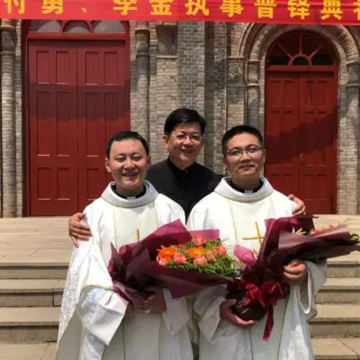
What Can CMSM Help With?

Slide 31
How helpful would it be if CMSM provided resources in these areas?
Percentage responding
 |  | “Somewhat” or “Very” Helpful Combined | “Very” Helpful
 | Formation programs for young religious to prepare them for future leadership roles | 83% | 42%
 | Ongoing formation resources | 83% | 40%
 | Resources on leadership formation | 80% | 44%
 | Resources about safeguarding formation | 76% | 32%
 | Formation and studies resources for members | 73% | 31%
 | Vocation effort resources | 72% | 39%
 | Resources on interculturality for your men in formation | 58% | 27%
 | Resources on interculturality for your fully professed members | 54% | 33%
 | Resources on interculturality for your leadership team | 51% | 28%
 | Formations and studies resources for lay partners | 49% | 14%

Slide 33
Final Thoughts - Context Matters…
Most CMSM Institutes are 50 or fewer men
Six in ten male religious are over age 63
One-quarter of Institutes have no one in formation, one-half have 1 to 5

Slide 34

Oxford University Press
2018

